Slide 1

Stream Analytics and Data Lakes
Divyesh B Chudasama

Slide 2
Pipeline Architecture
Create a storage account (Blob storage) on Azure Portal and create a container.
Place the source file in the container and connect to Azure Blob account (using the storage account name and key for the connection – configure this in the App.config file of the project in Visual Studio).
Download the Blob and read it
Turn it into an object (used Newtonsoft.json nugget package to deserialize it as a list of type x).
Iterate over the list and send a message on an event hub once every .5 seconds.
Then use Azure Stream Analytics to pull events off event hub and push to Azure Data Lake.
In Azure Data Lake generate a set of metrics (U-SQL project in Visual Studio).
Visualise the metrics using PowerBI.
Focus is on stages highlighted in red.

Slide 3
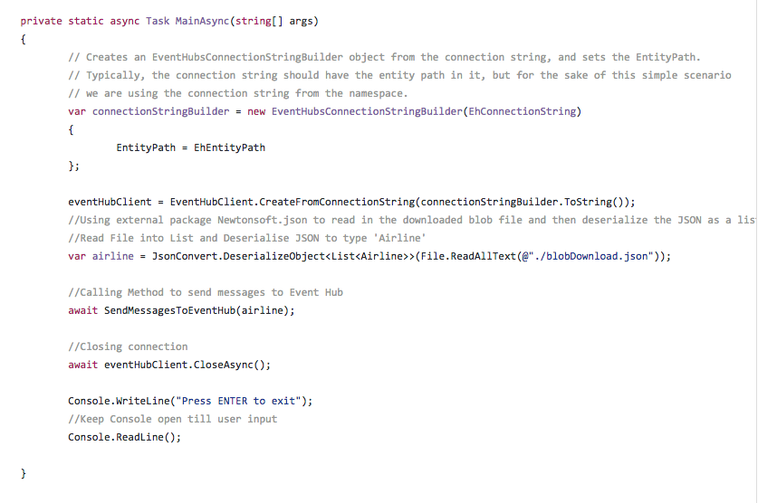
Newtonsoft.json

Slide 4
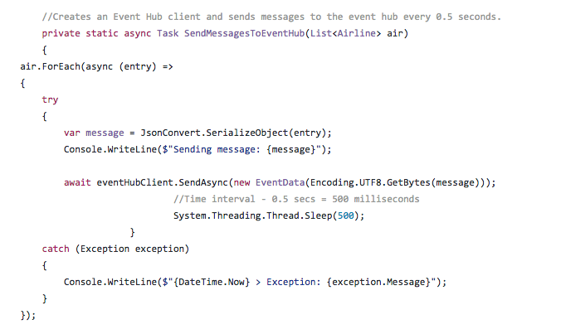
Iteration

Slide 5
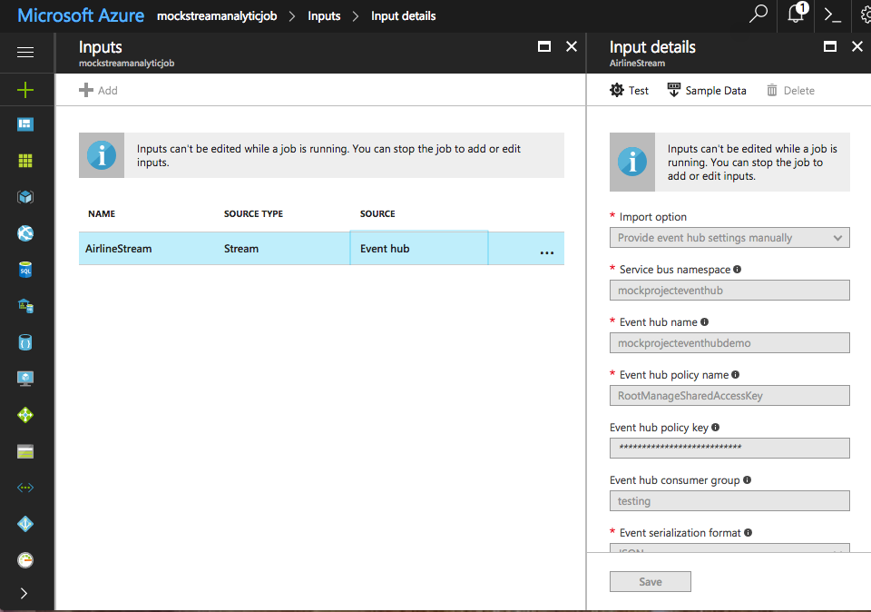
Stream Analytics

Slide 6
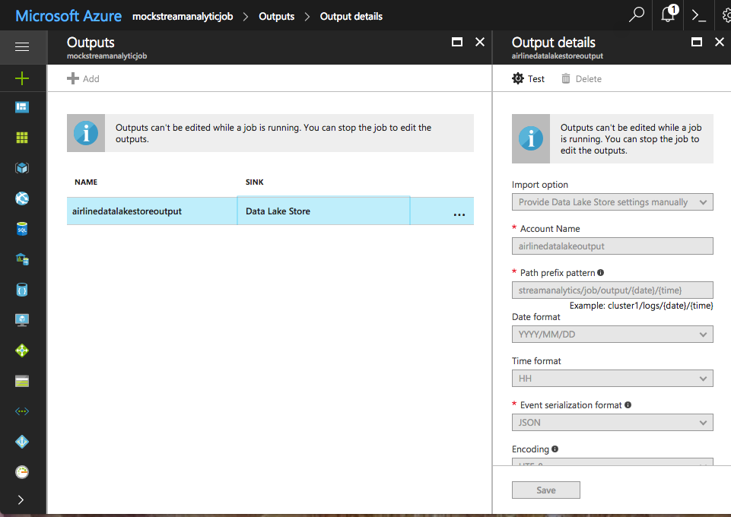
Data Lake

Slide 7
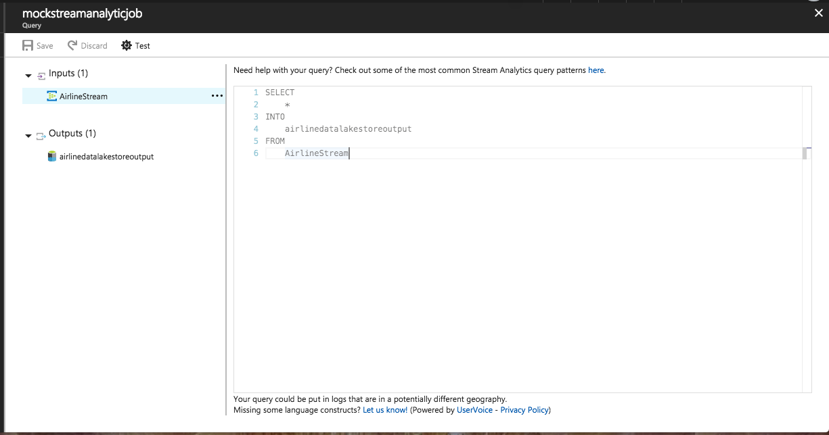
Query

Slide 8
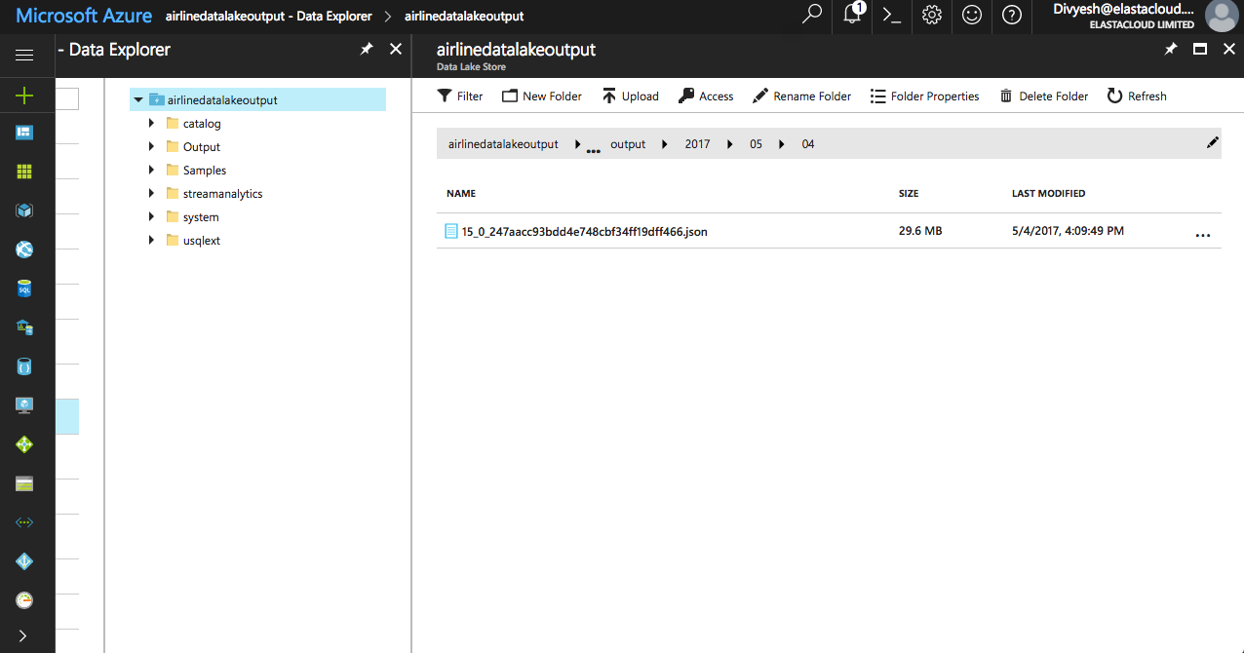
Output

Slide 9
U-SQL
U-SQL is a language that combines the benefits of SQL with the expressive power of your own code to process data at any scale.
U-SQL differs in some ways from ANSI SQL or T-SQL i.e. keywords such as SELECT must be in all-uppercase.
A Data Lake analytics Job using U-SQL can be run both via the Azure Portal or via a U-SQL Visual Studio Project.

Slide 10
Microsoft.Analytics.Samples.Formats
In order to be able to achieve JSON Extraction from Data Lake we need to the above project.
Will make JSON Extraction a lot easier.
Currently working on getting this to work with my project.
https://github.com/Azure/usql/tree/master/Examples/DataFormats/Microsoft.Analytics.Samples.Formats

